Slide 1



CAP 3104 Human and Technology Interaction Assignment 4 Group 30

Slide 2
Cohesive Teamwork
Working together as a cohesive team
Kevin Laszuk – Role: Presentation / Documentation
Eric Kevern – Role: mySql Database / User Interface Designer
Tristen Benham – Role: Project Manager / Graphic Artist
Frank Frana – Role: Presentation / User Interface Designer

Slide 3
Images of Developed User Interface and Requirements Associated with Them

Slide 4
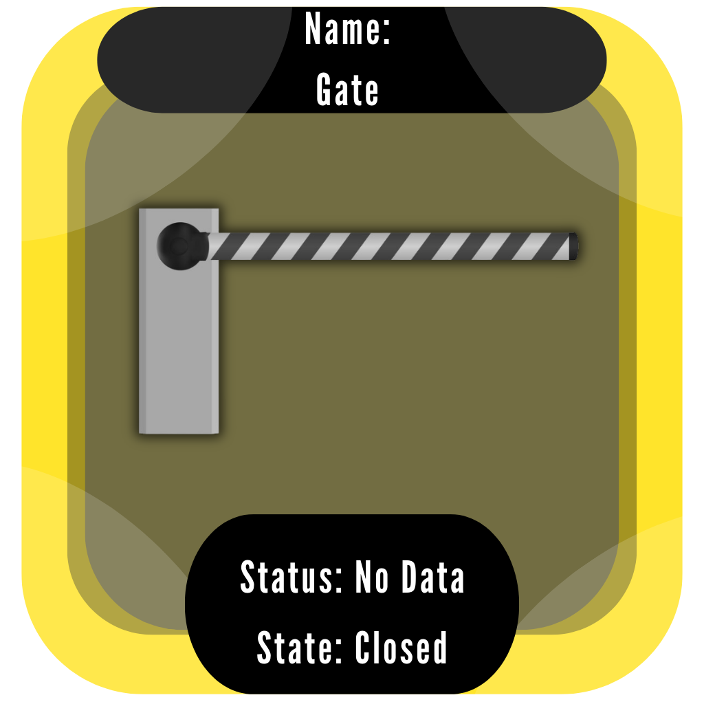
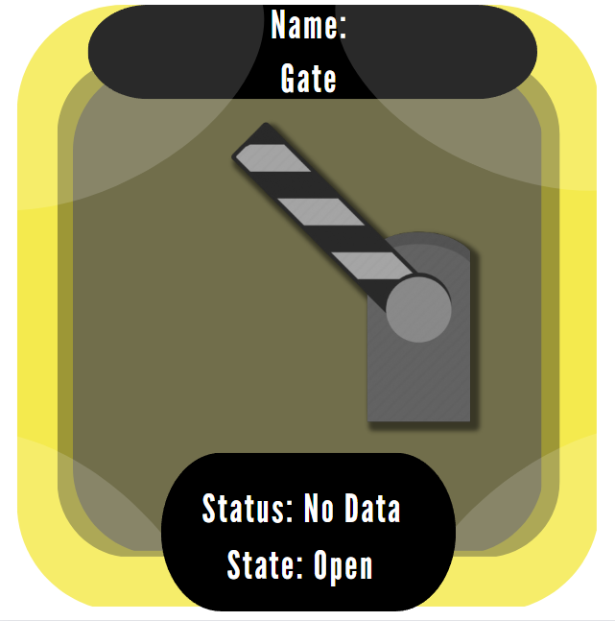
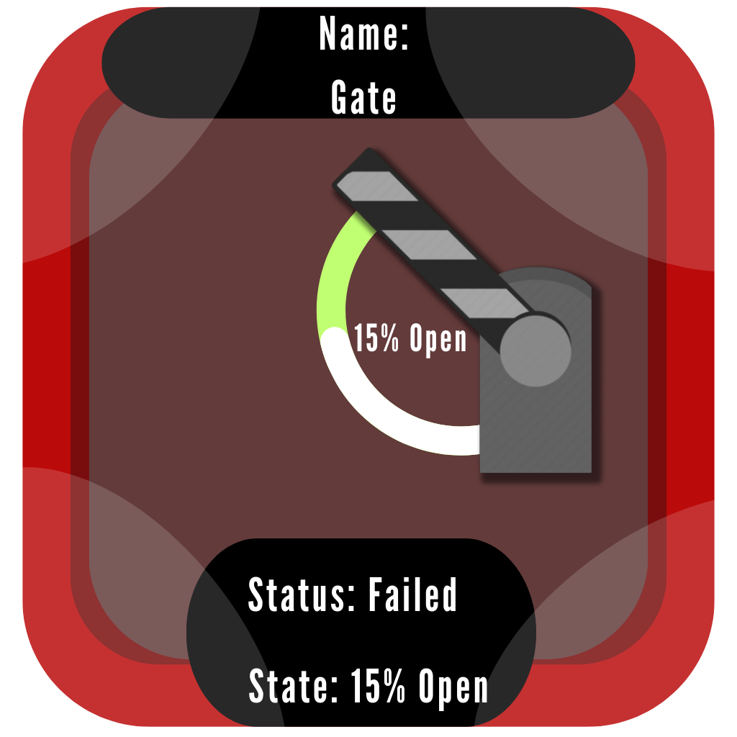
Gates
3.2.1.1.1
An icon shall be selected during detailed design to show a gate in a closed position
3.2.1.1.2
An icon shall be selected during detailed design to show a gate in an open position
3.2.1.1.3
An icon shall be selected during detailed design to show a gate in a partially open (15%) open position
3.2.1.1.4
The gate icon shall be configurable to show the name of the gate with the icon
3.2.1.1.5
The gate icon shall be configurable to show the state of the gate (e.g., open or close)

Slide 5
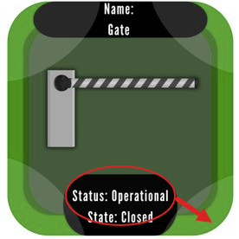
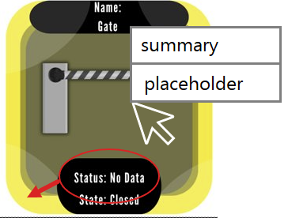
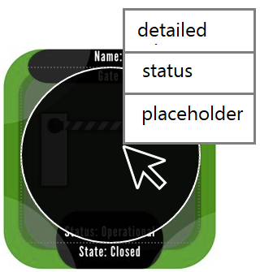
Gates 2
3.2.1.1.8
The operator shall be able to activate a detailed device status window for the selected gate by double left clicking on the icon. This action shall cause a circle to be displayed over the gate icon for as long as the detailed device status window is displayed for that gate.
3.2.1.1.7
When the operator moves the mouse over a gate icon a text window shall be displayed showing a summary of the gate status. The details of the summary status display will be defined in the GUI design document.
3.2.1.1.6
The gate icon shall be configurable to show the status of the gate (operational, failed, or no data). The color of the gate icon shall be changed to show the status of the gate

Slide 6
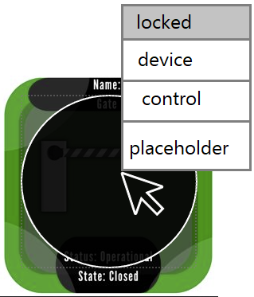

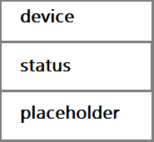

Gates 3
3.2.1.1.9
The operator shall be able to activate a device control window for the selected gate by right clicking on the icon. The right click on the icons shall display a pop-up menu of available device actions from which the user may select. This action shall cause a circle to be displayed over the gate icon for as long as the device control window is displayed for that gate.
3.2.1.1.8
The operator shall be able to activate a detailed device status window for the selected gate by double left clicking on the icon. This action shall cause a circle to be displayed over the gate icon for as long as the detailed device status window is displayed for that gate
3.2.1.1.9.1
If operation of the device is locked out for safety reasons a command option will be “grayed out”

Slide 7
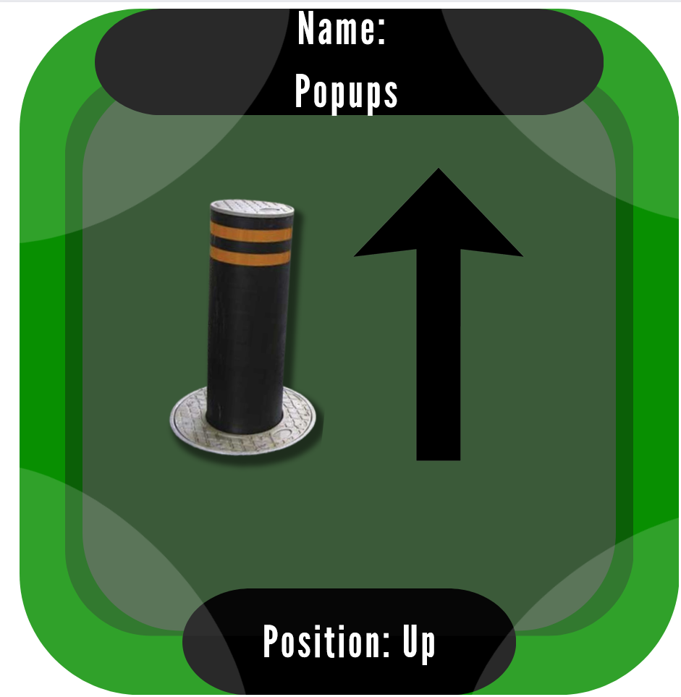
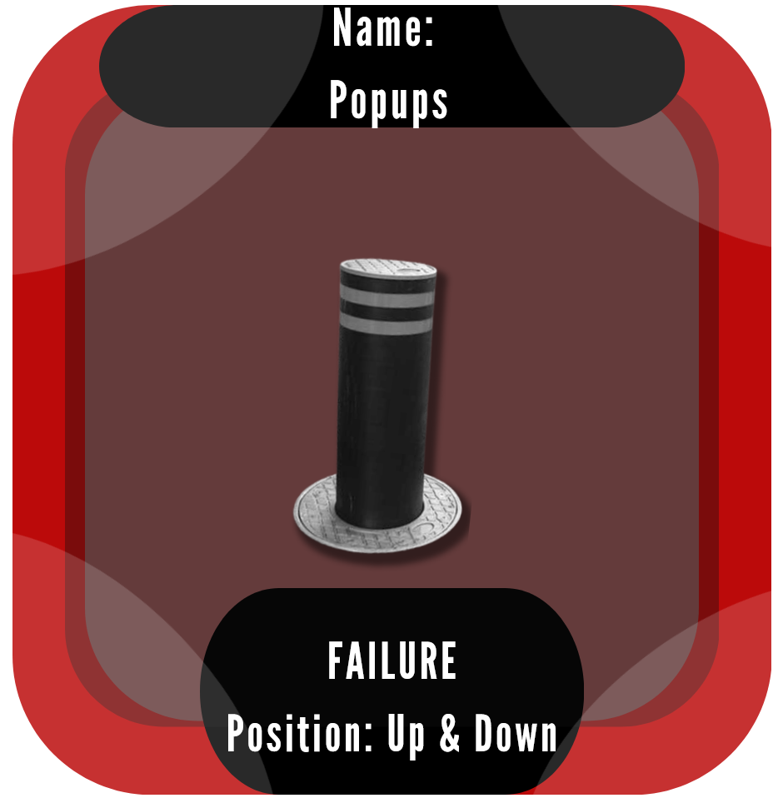
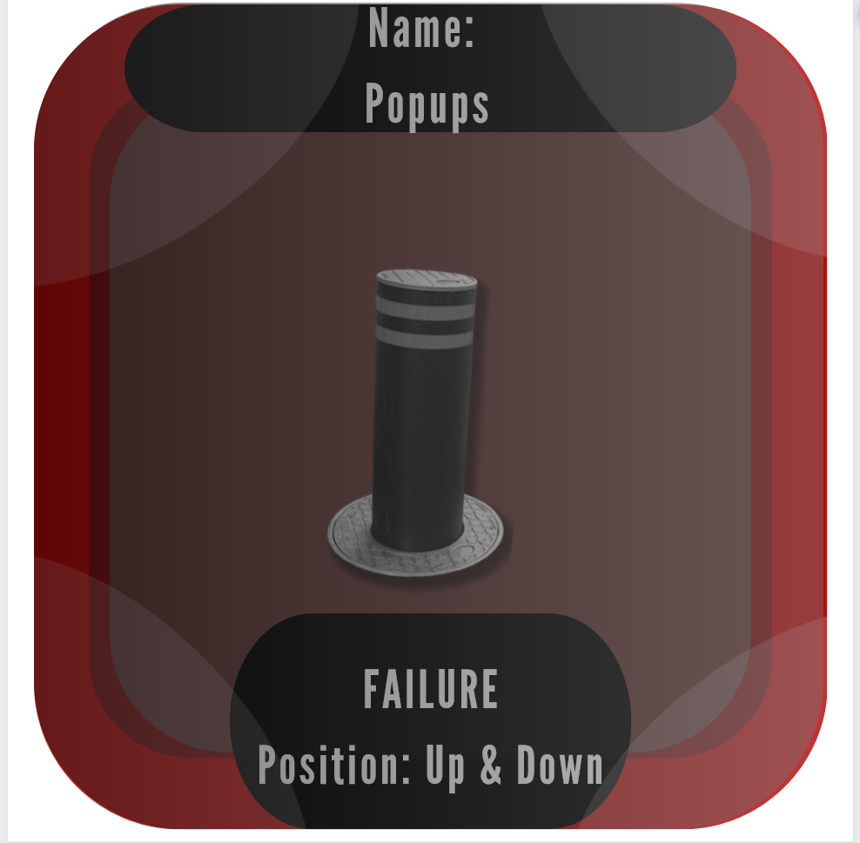
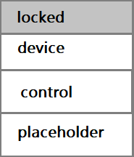
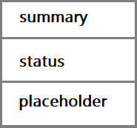
Popups
3.2.1.2.9
The operator shall be able to activate a device control window for the selected popup by right clicking on the icon. The right click on the icon shall display a pop-up menu of available device actions from which the user may select. A circle shall be displayed over the icon as long as the device control window is displayed for the icon.
3.2.1.2.7
When the operator moves the mouse over a popup icon a text window shall be displayed showing a summary of the popup group status. The details of the status display will be defined in the GUI design document.
3.2.1.2.8
The operator shall be able to activate a detailed device status window for the selected popup group by double left clicking on the icon. A circle shall be displayed over the icon as long as the detailed status window is displayed for the icon.
3.2.1.2.9.1
If operation of the device is locked out for safety reasons a command option will be “grayed out” and not selectable.

Slide 8
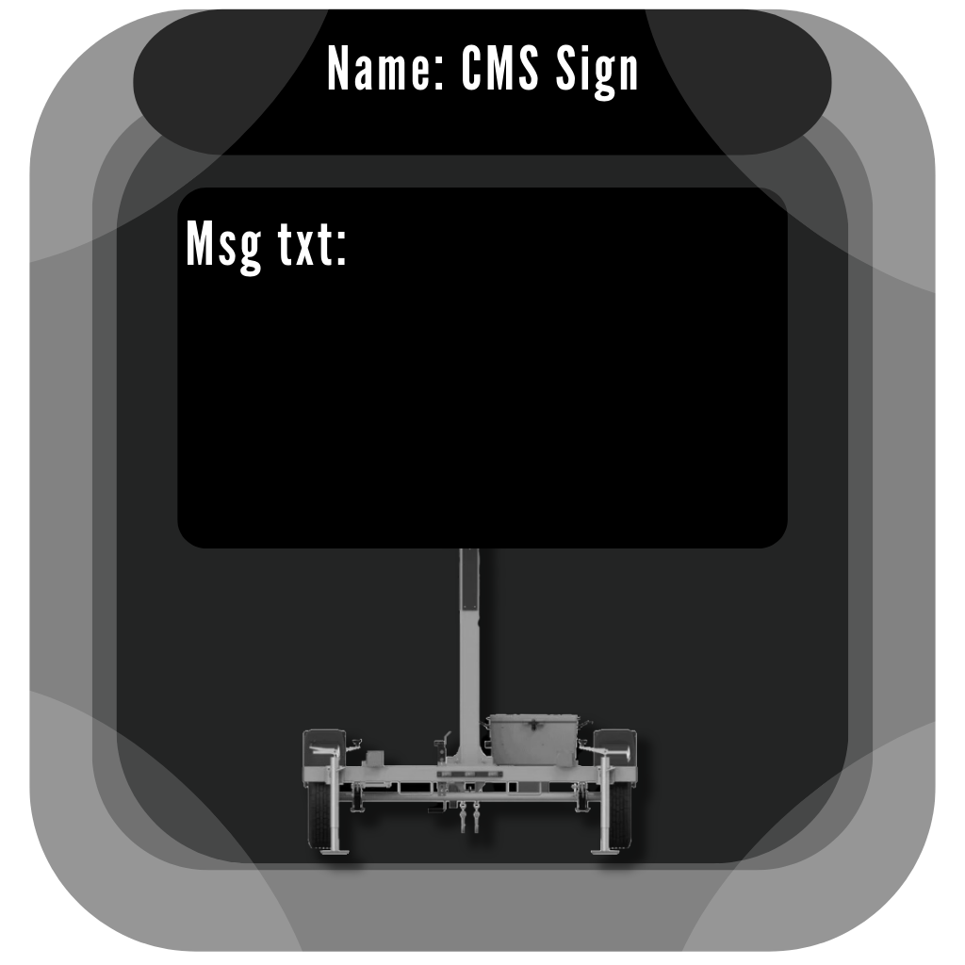
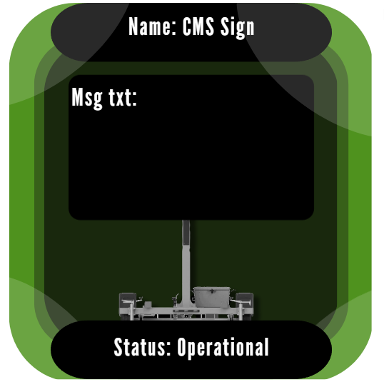
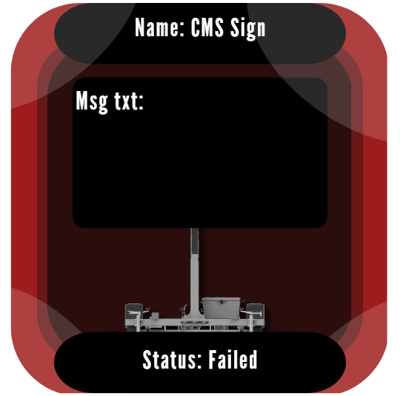
CMS
3.2.1.3.1
An icon shall be selected during detailed design to indicate changeable message signs
3.2.1.3.2
An icon shall be selected during detailed design to indicate a changeable message sign that is displaying a message
3.2.1.3.5
The CMS icon shall be configurable to display the status of the sign associated with the icon. The CMS icon color shall represent the operational status of the CMS sign: green for operational, yellow for operational with errors, gray for no communications and red for failed
3.2.1.3.3
The CMS icon shall be configurable to display the name of the sign with the icon
3.2.1.3.4
The CMS icon shall be configurable to display an abbreviated message text with the icon

Slide 9
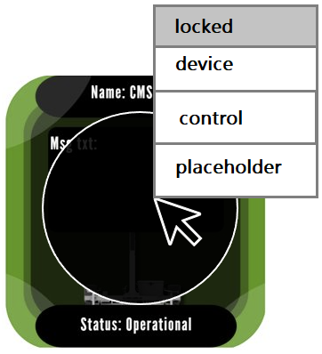
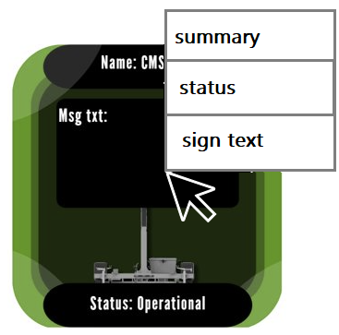
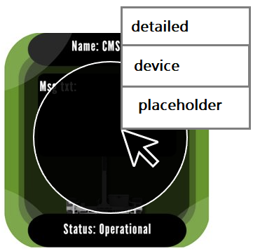
CMS 2
3.2.1.3.8
The operator shall be able to activate a device control window for the CMS sign by right clicking on the selected icon. The right click on the icon shall display a pop-up menu of available device actions from which the user may select. A circle shall be displayed over the icon as long as the device control window is displayed for that icon
3.2.1.3.6
If the operator moves the mouse over the CMS icon then a text window shall be displayed with a summary of the operational state and status of the sign and the text of any message being displayed on the sign
3.2.1.3.7
The operator shall be able to activate a detailed device status window for the sign by double left clicking on the selected icon. A circle shall be displayed over the icon as long as the detailed device status window is displayed for that icon
3.2.1.3.8.1
The CMS icon shall be configurable to display the status of the sign associated with the icon. The CMS icon color shall represent the operational status of the CMS sign: green for operational, yellow for operational with errors, gray for no communications and red for failed

Slide 10

CCTV
3.2.1.4.1
An icon shall be selected to indicate a CCTV camera
3.2.1.4.2
The camera icon shall be configurable to show the name of the camera with the icon
3.2.1.4.3
The camera icon shall be configurable to show the state of the camera
3.2.1.4.4
The camera icon shall be configurable to show the status of the camera. The color of the camera icon shall be changed to show the status of the camera

Slide 11
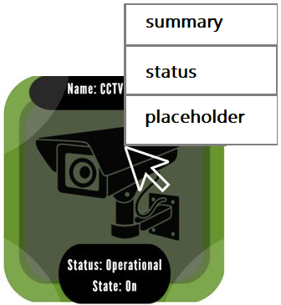
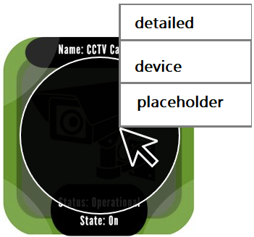
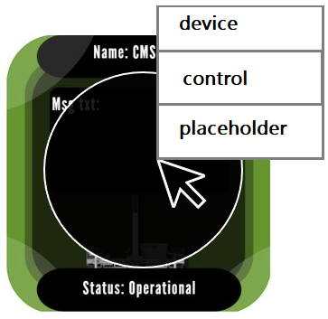
CCTV 2
3.2.1.4.5
When a user moves the mouse over a camera icon a text window shall be displayed showing a summary of the camera status
3.2.1.4.6
The user shall be able to activate a detailed device status window for the selected camera by double left clicking on the icon. This action shall cause a circle to be displayed over the camera icon for as long as the detailed device status window is displayed for that camera
3.2.1.4.7
The user shall be able to activate a device control window for the selected camera by right clicking on the icon. The right click on the icon shall display a pop-up menu of available device actions from which the user may select. This action shall cause a circle to be displayed over the camera icon for as long as the device control window is displayed for that camera

Slide 12
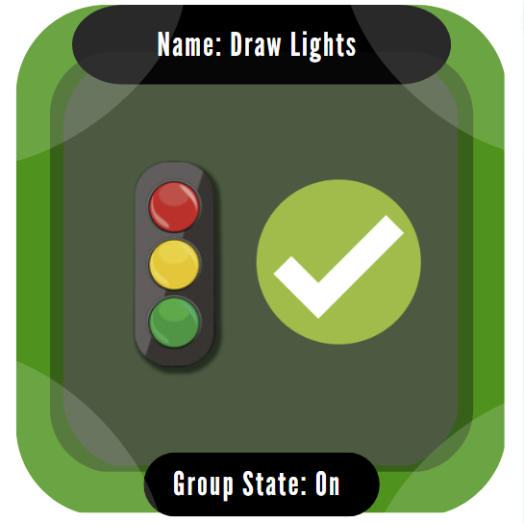
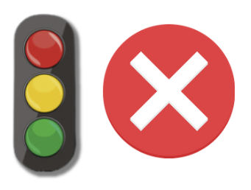

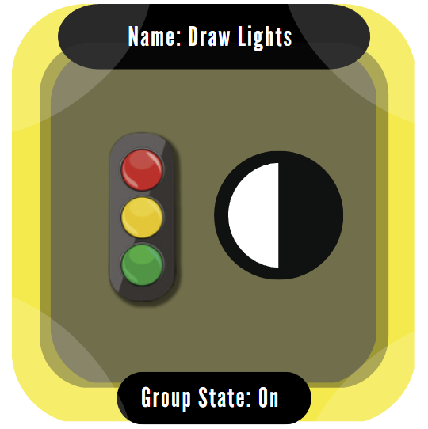
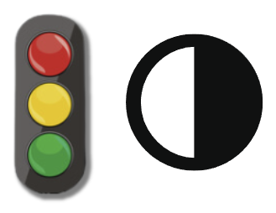
Draw Lights
3.2.1.5.4
The draw light icon shall be configurable to display the name of the draw lights
3.2.1.5.1
An icon shall be selected during detailed design to indicate a group of draw lights that are off
3.2.1.5.2
An icon shall be selected during detailed design to indicate a group of draw lights that are on
3.2.1.5.6
The draw light icon shall be configurable to display the status of the draw lights. The color of the draw light icon shall represent the status of the draw light: green for operational, yellow for operational with errors, gray for no communications and red for failed
3.2.1.5.3
An icon shall be selected during detailed design to indicate a group of draw lights where some are on and some are off
3.2.1.5.5
The draw light icon shall be configurable to display the state of the draw lights

Slide 13
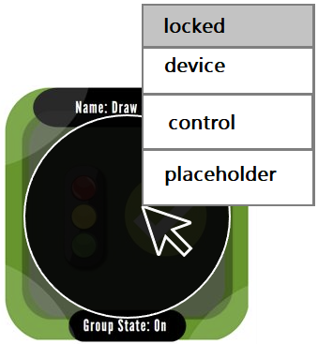
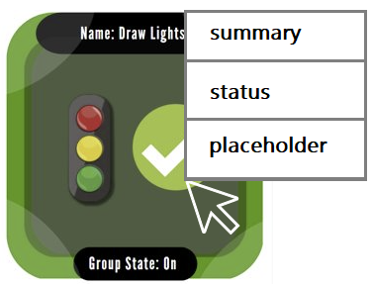
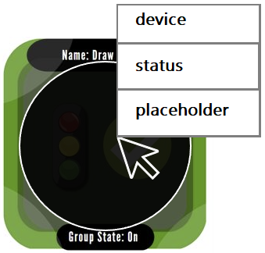
Draw Lights 2
3.2.1.5.9
The operator shall be able to activate a device control window for the draw lights by right clicking on the selected icon. The right click on the icon shall display a pop-up menu of available device actions from which the user may select. A circle shall be displayed over the icon as long as the device control window is displayed for that icon
3.2.1.5.7
When the operator moves the mouse over a draw light icon a text window shall be displayed showing a summary of the status of the group of draw lights. The details of the status display will be defined in the GUI design document
3.2.1.5.8
The operator shall be able to activate a detailed device status window for the draw lights by double left clicking on the selected icon. A circle shall be displayed over the icon as long as the detailed device status window is displayed for that icon
3.2.1.5.9.1
If operation of the device is locked out for safety reasons the command option will be “grayed out” and not selectable

Slide 14
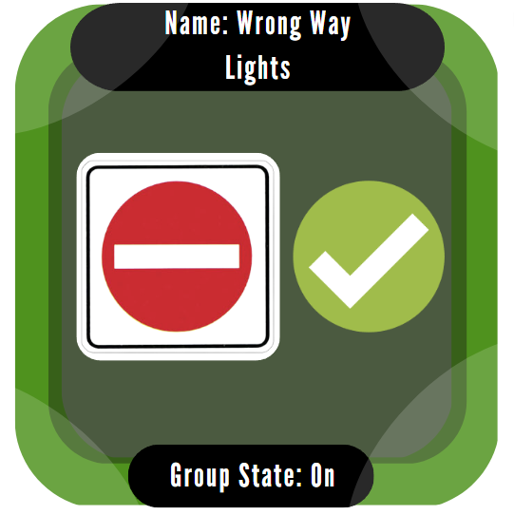


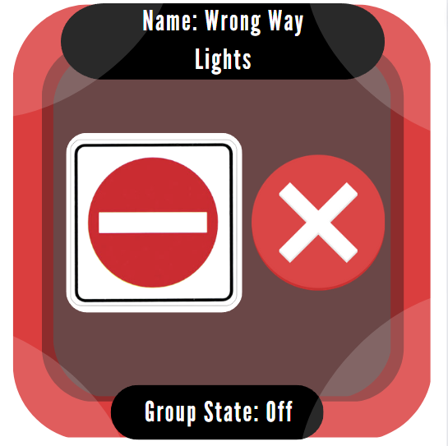

Wrong Way Lights
3.2.1.6.4
The wrong way light icon shall be configurable to display the name of the draw lights
3.2.1.6.1
An icon shall be selected during detailed design to indicate a group of wrong way lights that are off
3.2.1.6.2
An icon shall be selected during detailed design to indicate a group of wrong way lights that are on
3.2.1.6.6
The wrong way light icon shall be configurable to display the status of the group of wrong way lights. The color of the wrong way light icon shall represent the status of the wrong way light: green for operational, yellow for operational with errors, gray for no communications and red for failed
3.2.1.6.3
An icon shall be selected during detailed design to indicate a group of wrong way lights where some are on and some are off
3.2.1.6.5
The wrong way light icon shall be configurable to display the state of the wrong way lights

Slide 15
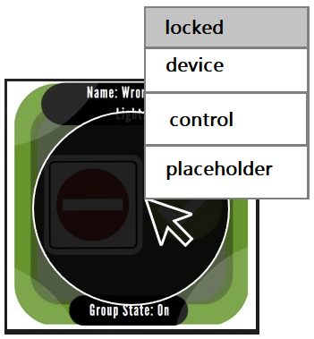
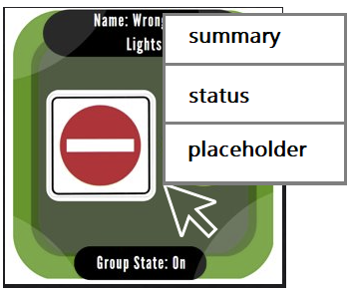
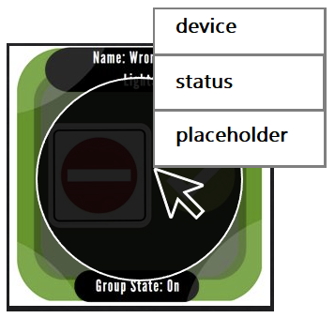
Wrong Way Lights 2
3.2.1.6.9
The operator shall be able to activate the control window for the wrong way light by right clicking on the selected icon. The right click on the icon shall display a pop-up menu of available device actions from which the user may select. A circle shall be displayed over the icon as long as the device control window is displayed for that icon
3.2.1.6.7
When the operator moves the mouse over a wrong way light icon a text window shall be displayed showing a summary of the status of the group of wrong way lights. The details of the status display will be defined in the GUI design document
3.2.1.6.8
The operator shall be able to activate a detailed device status window for the wrong way lights by double left clicking on the selected icon. A circle shall be displayed over the icon as long as the detailed device status window is displayed for that icon
3.2.1.6.9.1
If operation of the device is locked out for safety a command option will be “grayed out” and not selectable

Slide 16
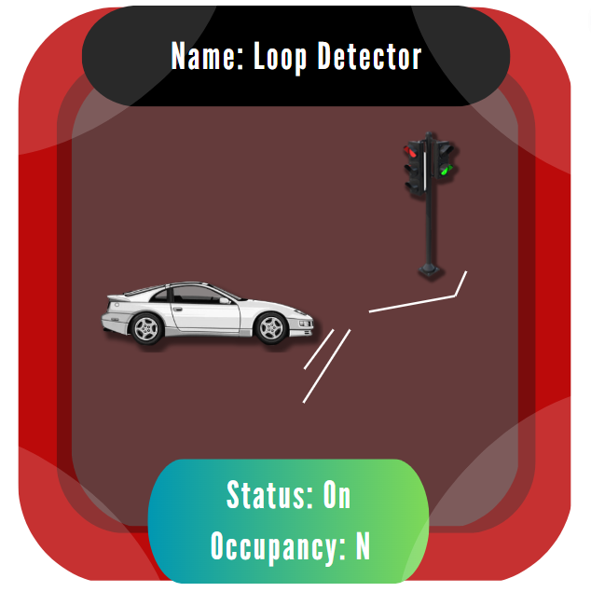
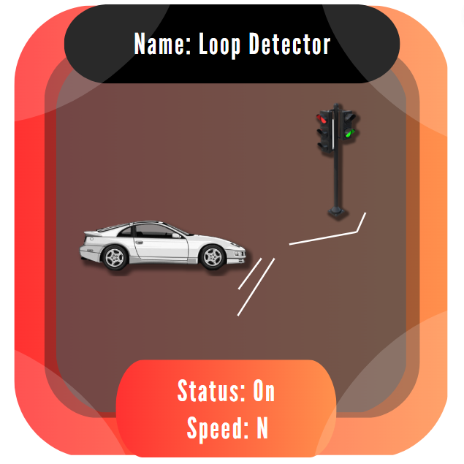
Loop Detectors
3.2.1.7.5
The data being displayed by a color shall be configurable.
3.2.1.7.1
An icon shall be selected during detailed design to indicate a loop detector
3.2.1.7.6
The range being displayed by a color shall be configurable.
3.2.1.7.2
An icon shall be selected detailed design to indicate a group of loop detectors
3.2.1.7.7
The range being displayed by a color shall be configurable
3.2.1.7.3
The loop detector and group detector icons shall use color to indicate speed, volume, or occupancy is within a specified range of if no data is available from the detector or from all loop detectors in a group.
3.2.1.7.4
The color used to indicate range shall be configurable.
3.2.1.7.8
The loop detector icon shall be configurable to display the name of the loop detector

Slide 17
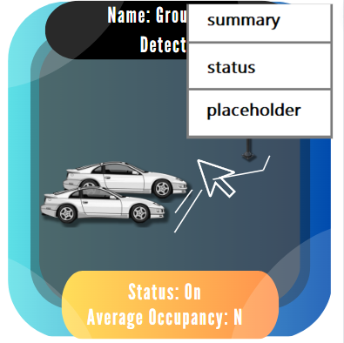
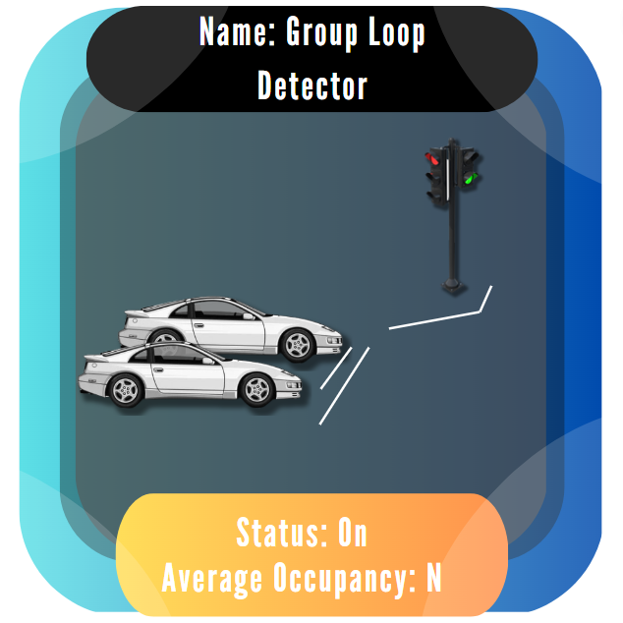
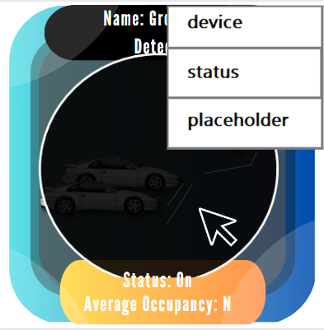
Loop Detectors 2
3.2.1.7.12
The detector loop icon shall be configurable to display the status of the loop detector or group of loop detectors.
3.2.1.7.13
When the operator moves the mouse over a detector loop icon a text window shall be displayed showing a summary of the status of the loop detector or the group of detector loops. The details of the status display will be defined in the GUI design document.
3.2.1.7.9
The loop detector icon shall be configurable to display the N second volume, speed and occupancy values as text associated with the icon. The value on N shall be configurable.
3.2.1.7.10
The group detector icon shall be configurable to display the name of the detector group name as text with the icon
3.2.1.7.11
The group detector icon shall be configurable to display the N second average of volume, speed and occupancy for all detectors in the group as text with the icon. The value of N shall be configurable.
3.2.1.7.14
The operator shall be able to activate a detailed device status window for the loop or group of loops by double left clicking on the selected icon. A circle shall be displayed over the icon as long as the detailed device status window for that icon

Slide 18
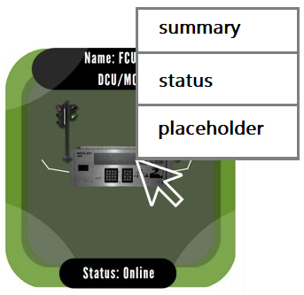
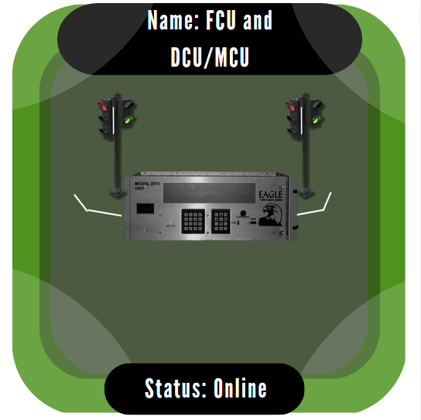
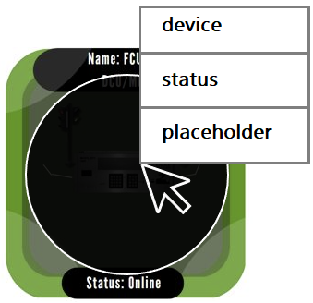
FCU and DCU/MCU
3.2.1.8.4
3.2.1.8.4 When the operator moves the mouse over an FCU or DCU/MCU icon a text window shall be displayed showing a summary of the site status. The details of the status display will be defined in the GUI design document
3.2.1.8.1
Icons shall be selected during detailed design to represent the FCUs and the DCU/MCUs
3.2.1.8.2
The FCU icon and the DCU/MCU icon shall be configurable to show the name of the site with the icon
3.2.1.8.5
The operator shall be able to activate a detailed device status window for the selected site by double left clicking on the icon. This action shall cause a circle to be displayed over the icon for as long as the detailed device status window is displayed for that site
3.2.1.8.3
The icons shall be configurable to show the status of the equipment at the site. The color of the icons shall be changed to show the status of the equipment

Slide 19
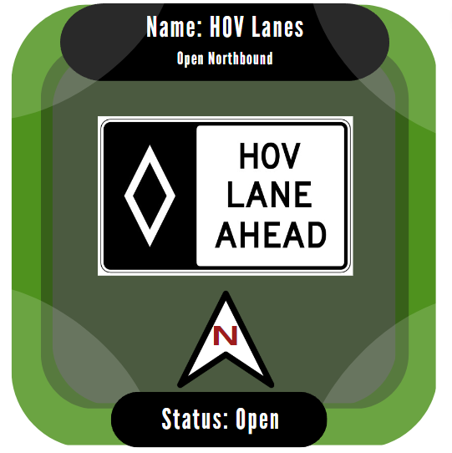

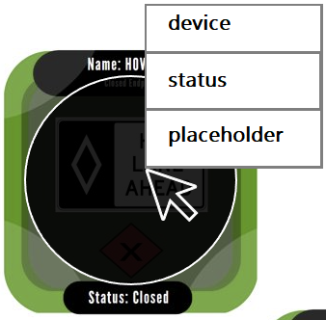
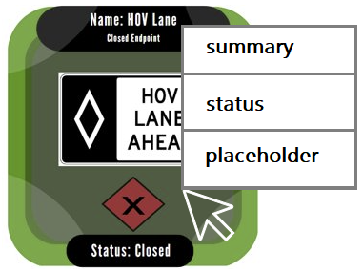
HOV End Points
3.2.1.9.4
The end point icon shall be configurable to show the status of the end point. The color of the icon shall be changed to show the status of the end point
3.2.1.9.1
An icon shall represent the end point of the HOV lanes (North and South). The icon shall have different shapes to represent that the end point is closed, open Southbound or open Northbound
3.2.1.9.2
The end point icon shall be configurable to show the name of the end point associated with the icon
3.2.1.9.3
The end point icon shall be configurable to show the state of the end point associated with the icon
3.2.1.9.5
When the operator moves the mouse over an end point icon a text window shall be displayed showing a summary of the end point status. The details of the summary status display will be defined in the GUI design document
3.2.1.9.6
The operator shall be able to activate a detailed device status window for the selected end point by double left clicking on the icon. This action shall cause a circle to be displayed over the icon for as long as the detailed device status window is displayed for that end point

Slide 20
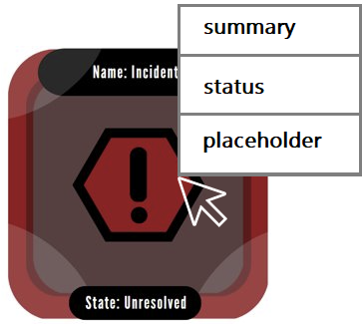
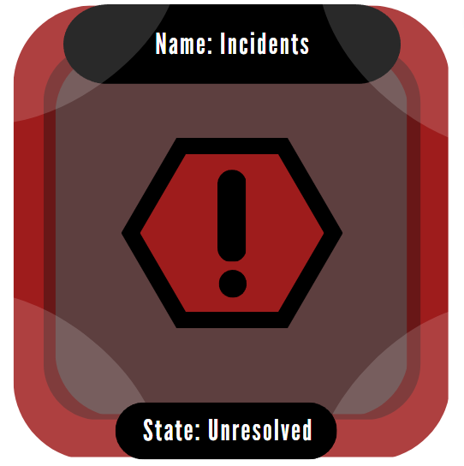
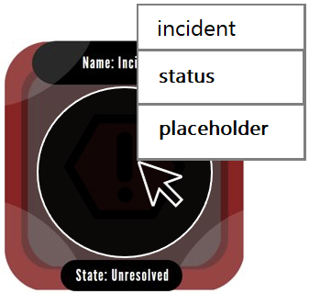
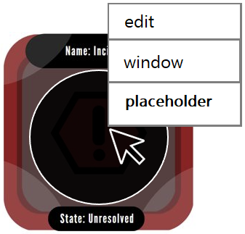
Incidents
3.2.1.10.3
When the operator moves the mouse over an incident icon a text window shall be displayed showing a summary of the incident state. The details of the summary state display will be defined in the GUI design document
3.2.1.10.1
An icon shall be selected during detailed design to represent active incidents
3.2.1.10.4
The operator shall be able to activate a detailed incident state window for the selected incident by double left clicking on the icon. This action shall cause a circle to be displayed over the incident icon for as long as the detailed device status window is displayed for that incident
3.2.1.10.2
The incident icon shall be configurable to display the state of the incident
3.2.1.10.5
The operator shall be able to activate an edit window for the selected incident by right clicking on thenicon. This action shall cause a circle to be displayed over the incident icon for as long as the edit window is displayed for that incident

Slide 21
HTI Discussion
Some HTI concepts that were applied to our software include consistency, universal usability, informative feedback, aesthetic and minimalistic in design, and learnability.
At the forefront of our design, we prioritized consistency, and minimalistic design to ensure universal usability and easy learnability. Through meeting customer requirements and clever design, we created icons that meet many HTI concepts, but prioritize concepts that help balance utility and visibility through consistent, minimalistic design.

